Slide 1
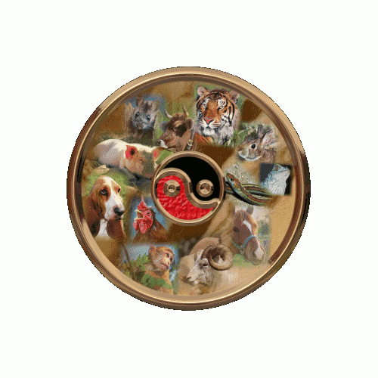
Spinning Circle

Slide 2
Before you begin this text animation, you will need to download a free animation plugin for GIMP® called GAP (GIMP Animations Package). Instructions to download are included on the Animations tab of the Web site.
This will add a new Video menu item to the GIMP® Menu Bar.

Slide 3
You will need a circular image to continue with this assignment. I used the Chinese Zodiac image at http://graphics.elysiumgates.com/chineseastrology.html
I decided it was a little large so I opened it in GIMP and selected Image | Scale image and scaled to 75%, which is about 242 pixels x 242 pixels. Save the image in the new size.

Slide 4
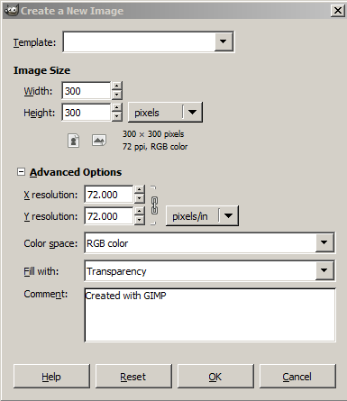
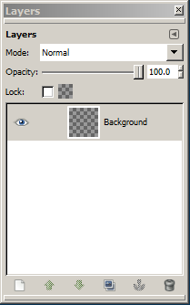
GIMP® is all about IT (Images and Text)
OPEN GIMP®
Step 1: To begin a new GIMP® project, from the Menu Bar, select File | New. At the Create a New Image dialog box, select a size and background color for your new image.
I selected 300 x 300 pixels with a transparent background.
You will need to click the + sign beside Advanced Options to expand the menu. In the Comment text box, describe the image. Click the OK button.
A new image canvas displays in the GIMP® workspace with image information in the Title Bar and a “Background” layer displays in the Layers palette to the right of the image window.

Slide 5
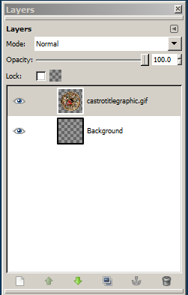
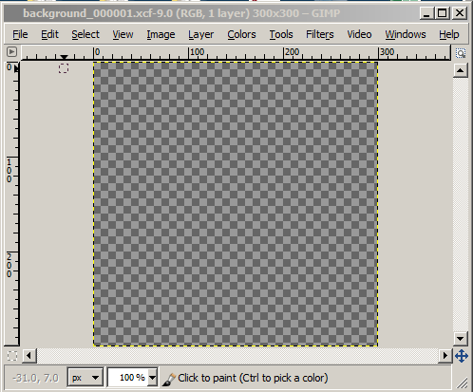
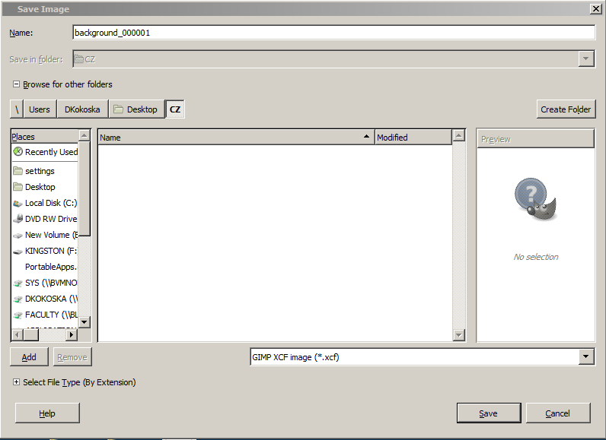
Drag the CZ image onto the transparent canvas. A new layer displays above the Background layer in the Layers palette.
Select File | New and start a new project with a size of 300px x 300px with a transparent background.
Save this new transparent background (which is now named Untitled) in a folder named CZ as background_000001.xcf.
The name is very important so be sure to name it as shown above.

Slide 6
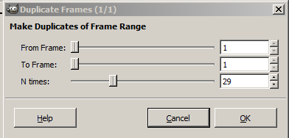
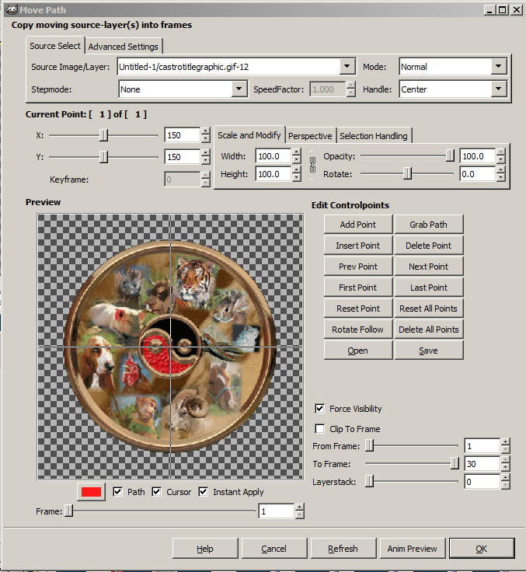
In the new background_00001.xcf file, select Video | Duplicate Frames and change the N times: text box to 29 and click the OK button.
#2
#3
In the background_00001.xcf file, select Video | Move Path and follow the steps in order.
#1 Shows the result of the selection immediately
#2 Selects the image to display (this should display automatically)
#3 Selects the alignment of the image
#4 Centers the image on the canvas (1/2 of 300px)
#4
#1

Slide 7
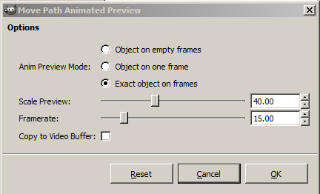
Complete Steps 5 and 6.
#5 Select Add Point
#6 Change the Rotate to 360
Click Anim Preview button
Click Exact object on frame
Change framerate: to 15.00
Click the OK button
#2
#3
#4
#6
#5
#1
Click the Play button to demo the animation
Click Close on both the Play window and the Untitled window – Don’t Save.

Slide 8
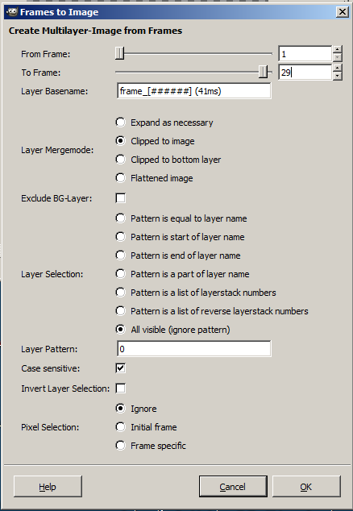
Click OK on the Move Path window.
In the background_00001.xcf window, click Video | Frames to Image and change the to Frame: to 29
This is because the 1st frame and the 30th frame are identical as 0 and 360 degrees are equal.
Click the OK button.
Save or export the new untitled image as Circle_Rotate.gif
Be sure to select Save as Animation
At the Save as GIF dialog box, Add a GIF comment and click Save.
Close the project. You do not need to save the original untitled image.

Slide 9
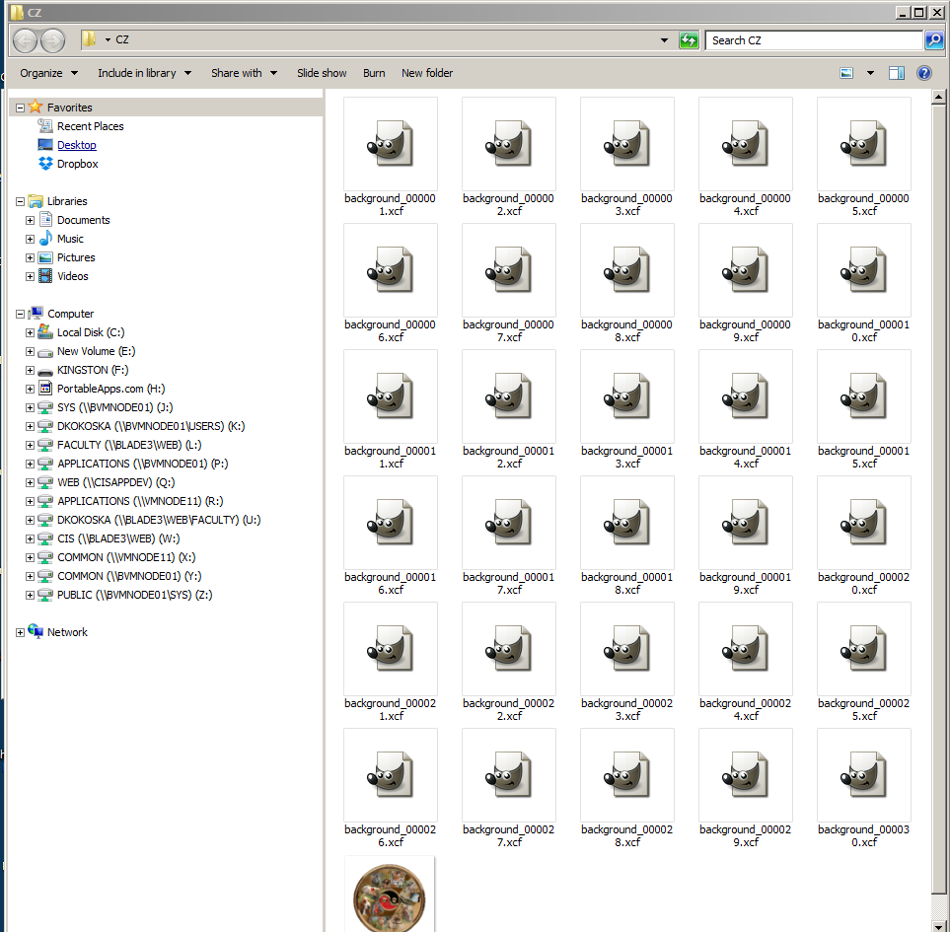
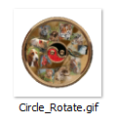
In the CZ folder, you have 30 background images labeled background_00001.xcf – background_000030.xcf and a Circle_Rotate.gif image
Delete all of files except the Circle_Rotate.gif image.
Open the Circle_Rotate.gif image in a browser to view the animation.

